Slide 1
PAY TOLL SYSTEM

Slide 2
SUBMITTED BY
Yash Khanokar ( 1816440213 )
Smitesh Khot ( 1816440407)
Sharad Patil ( 1816440202)
Sahil Mulla ( 1816440201 )
Under The Guidance Of
Mr. Naresh Kamble
DEPARTMENT OF COMPUTER SCIENCE AND ENGINEERING

Slide 3
INTRODUCTION
In our project we customize the Toll Pay system to the less time consuming and user friendly process. Application is user friendly, safe for payment. You can pay the toll amount using UPI, net banking, credit/debit card. We customize and proposed this system to make the traffic free lens at toll plaza, less time consuming payment process for the users. We also provide demo video (How to use Pay-Toll Application) in our project for those who unable use the application.
The application will support implementation and refinement of the system that has been developed for users. In this project users will get map navigation in the feature of toll pay in route, so user does not need to open google map navigation separately. Quick scan is also usable feature for the user. It can be use at the emergency or if user know their complete travel route. A demo video is also provided.

Slide 4
PURPOSE
Overcome slow payment process as it done manually
Make payment easily with Pay Toll application
Keep track of all toll payments in history
Some travelers are forgot to bring card/cash.

Slide 5
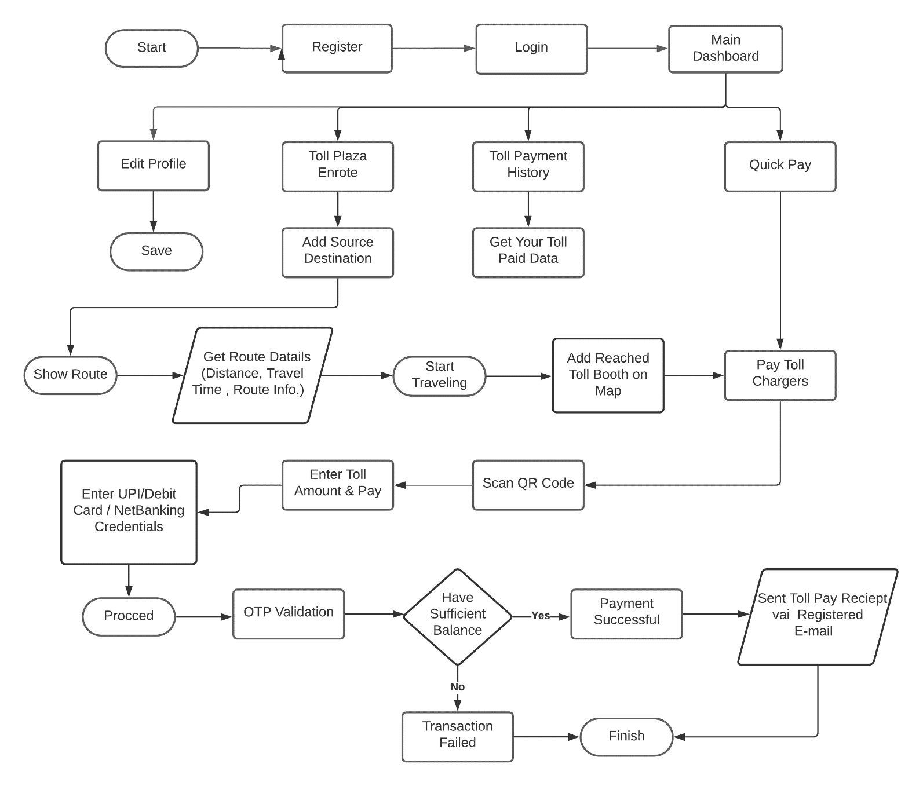
FLOWCHART

Slide 6
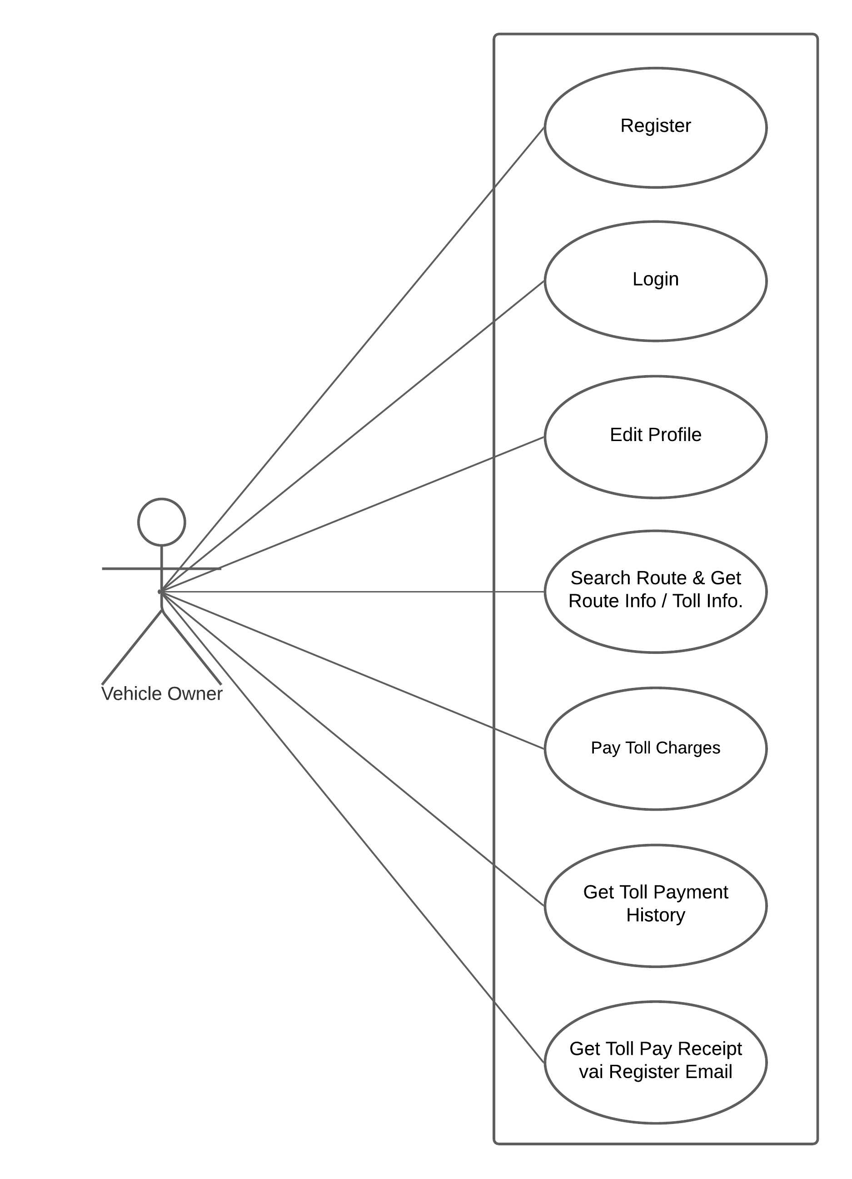
USE CASE DIAGRAM

Slide 7
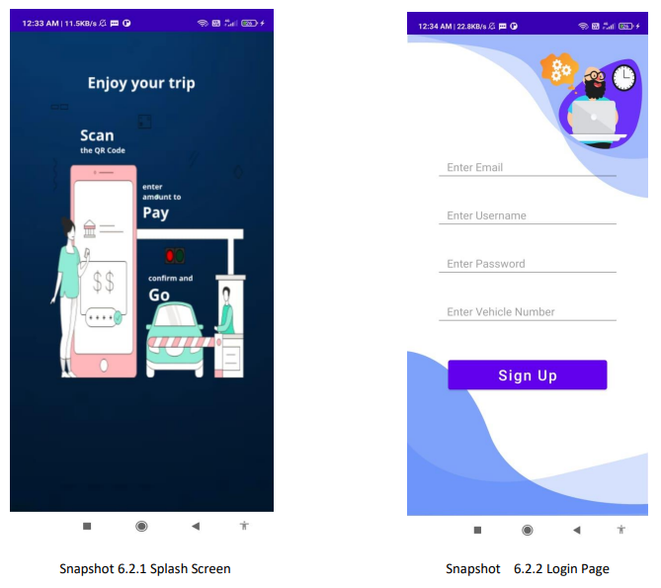
APPLICATION SNAPSHOTS

Slide 8
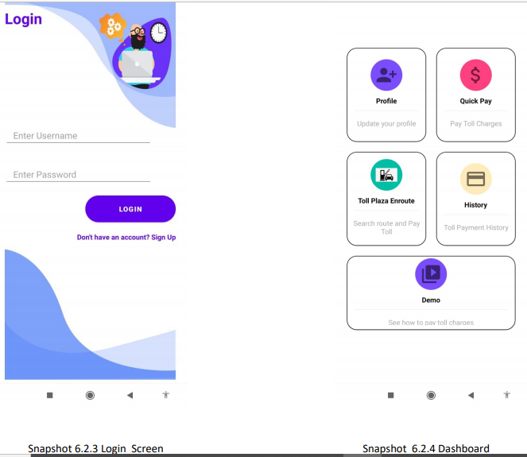
APPLICATION SNAPSHOTS

Slide 9
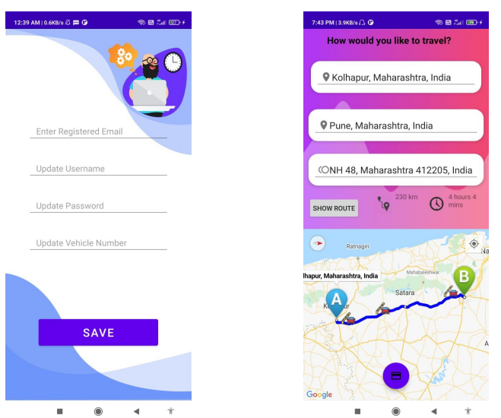
APPLICATION SNAPSHOTS

Slide 10
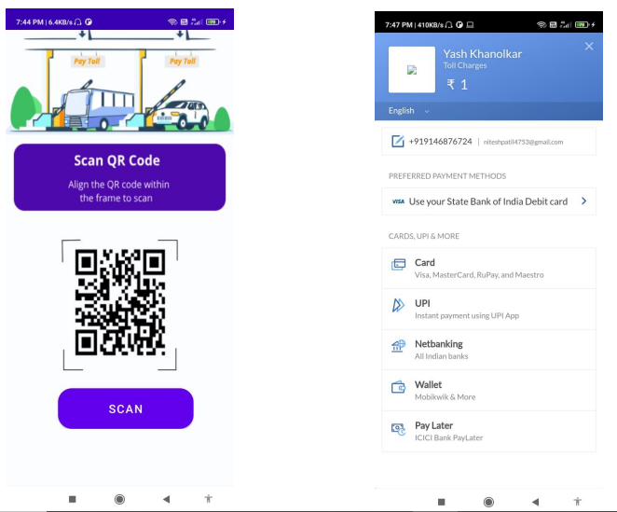
APPLICATION SNAPSHOTS

Slide 11
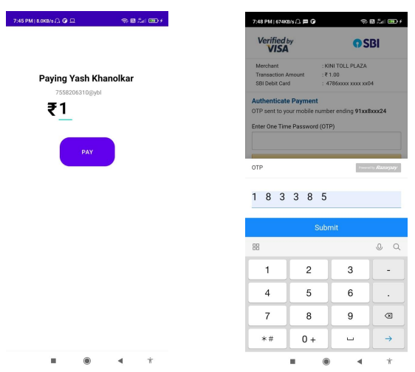
APPLICATION SNAPSHOTS

Slide 12
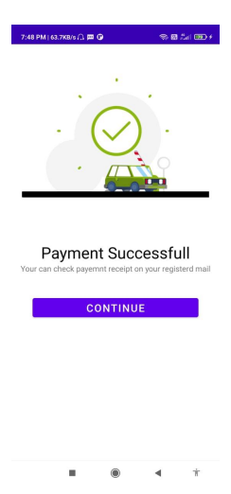
APPLICATION SNAPSHOTS

Slide 13
ADVANTAGES
To Controls traffic
To reduce the time consumption
Reducing long vehicle lens
User friendly
Safe and secure

Slide 14
USE OF PROJECT
Less time consuming
Safe secure transaction
No need to open separate navigation app
We can get history of all payment make at toll plaza

Slide 15
HARDWARE AND SOFTWARE SPECIFICATION
Software Configuration
Operating System : Windows 8 Or Higher
LANGUAGES : Java
DATA SERVER : SQLite
Payment Getaway : Rozorpay
Google Maps API : Places API, Direction API, Maps SDK
Hardware Configuration
Vehicle Owner : Android Phone
Toll Collector : QR Code Scanner

Slide 16
Thank You

